Slide 1

Personalized Finance Tracker: ML-Powered Goal Saving
Revolutionizing personal finance with AI to track, predict, and achieve your goals. Using LSTM and Random Forest models, we deliver tailored financial insights.
Presented by
B Sharanya 21911A6706
D Vikram 21911A6722
M Shriya 21911A6745
K Santhoshi 21911A6761

Slide 2

The Problem: Generic Financial Advice Fails
Generic Budgets Fail
Personal Insights Lacking
No Predictive Analysis
One-size-fits-all advice often misses personal spending patterns.
Users struggle without tailored financial guidance.
Without forecasts, goal setting lacks accuracy and motivation.

Slide 3
Our Solution: AI-Driven Personalized Finance
Intelligent Tracking
Predictive Analysis
Goal-Based Saving
Intuitive Visualizations
Automated expense categorization and monitoring using AI.
Forecasts future spending to optimize savings plans.
Automated, personalized savings plans adapting to your progress.
Clear charts and insights make decision-making simple.

Slide 4

Machine Learning Models: LSTM for Time-Series Forecasting
Sequential Data Analysis
Accurate Predictions
92% accuracy on monthly grocery expense forecasts.
LSTM captures long-term spending habits effectively.
High Volume Processing
Handles over 500,000 daily transactions continuously.

Slide 5

Machine Learning Models: Random Forest for Personalization
Tailored Advice
User Segmentation
Random Forest identifies key spending factors to customize tips.
Groups users by financial behaviors for precise strategies.
Engagement Boost
Personalized tips increase user interaction by 45%.

Slide 6
Key Features: Intelligent Tracking & Categorization
Automated Tracking
Smart Categorization
Custom Categories
Seamless expense import from bank and credit accounts.
Uses NLP to assign 98% of transactions correctly.
Users control categories for detailed financial views.

Slide 7
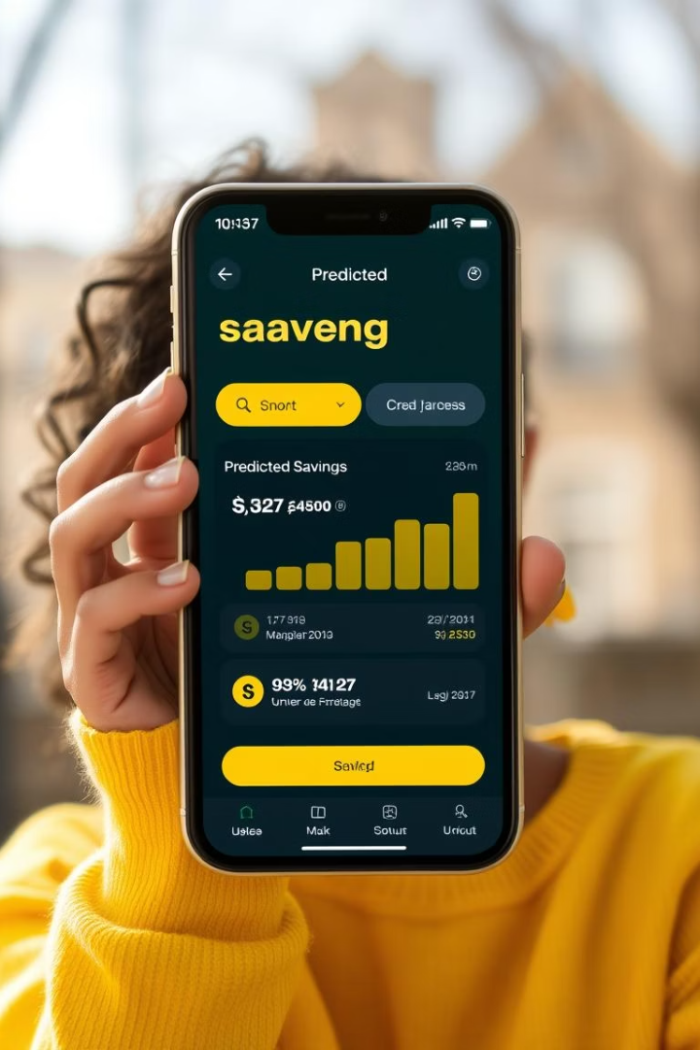
Key Features: Predictive Analytics & Goal Setting
Income & Expense Forecasts
90% accuracy predicting financial flows ahead.
Realistic Goals
Sets achievable savings targets tailored to behavior.
Progress Alerts
Timely notifications to keep users motivated.

Slide 8
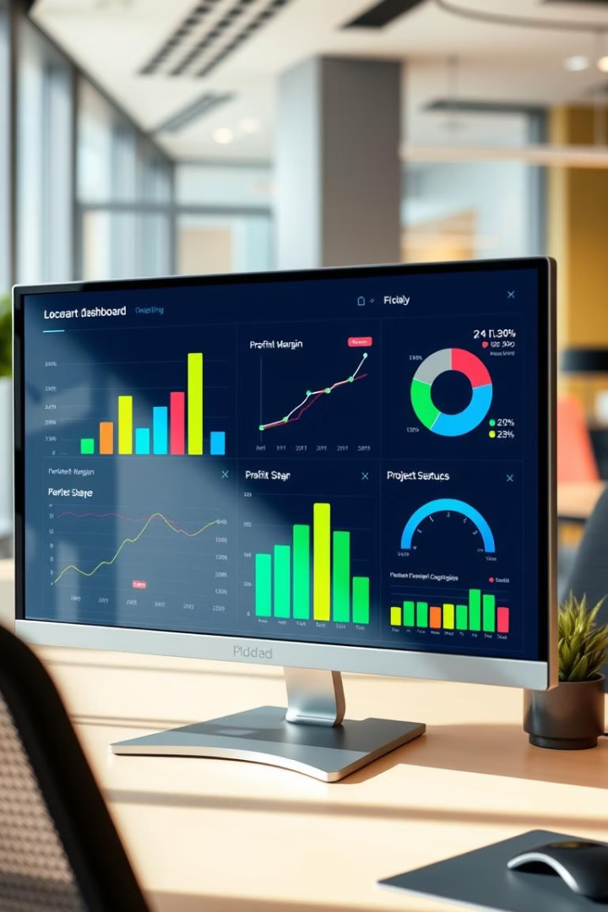



Visualizations: Intuitive Dashboards & Reports
Spending Breakdown
Trends Over Time
Goal Progress
Track evolving financial habits and net worth growth.
Monitor savings goals with clear, motivating charts.
Visualize expenses by category at a glance.

Slide 9





Conclusion: Empowering Financial Success with AI
Personalized AI Finance Tracker
Powerful ML Models
Helping users hit financial goals with smart insights.
LSTM and Random Forest for accurate predictions.
1
2
Join the Revolution
Intuitive Visuals
4
3
Clear dashboards support informed money decisions.
Transform how you manage your finances with AI.

